Slide 1
Data Inceptionists
Frank Liu, Ryan Cambell

Slide 2
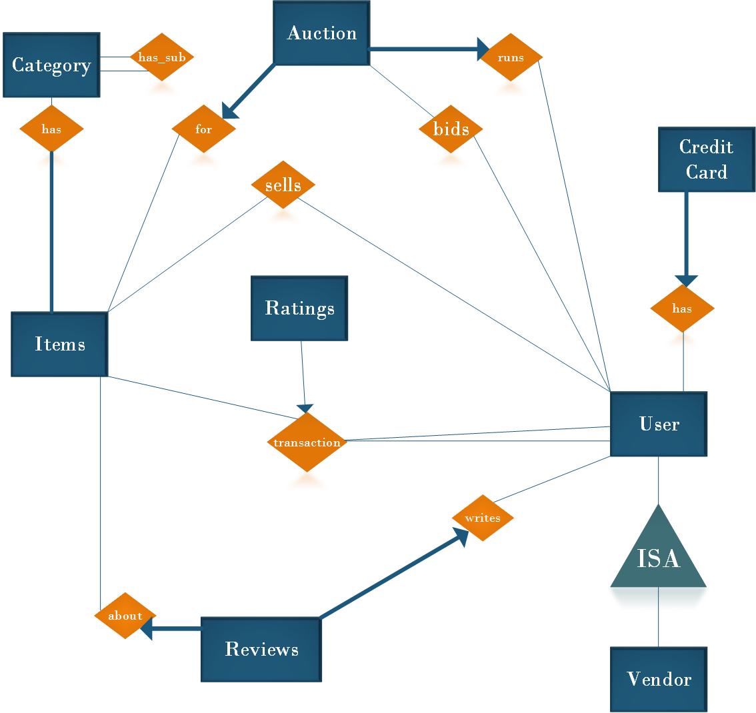
Overview

Slide 3
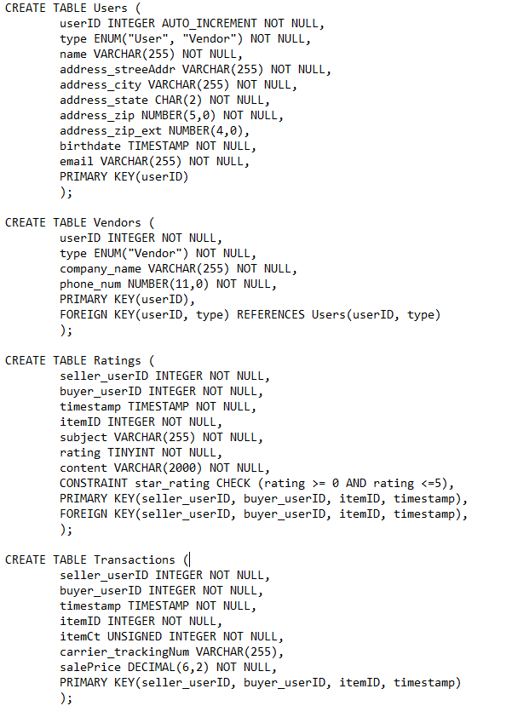
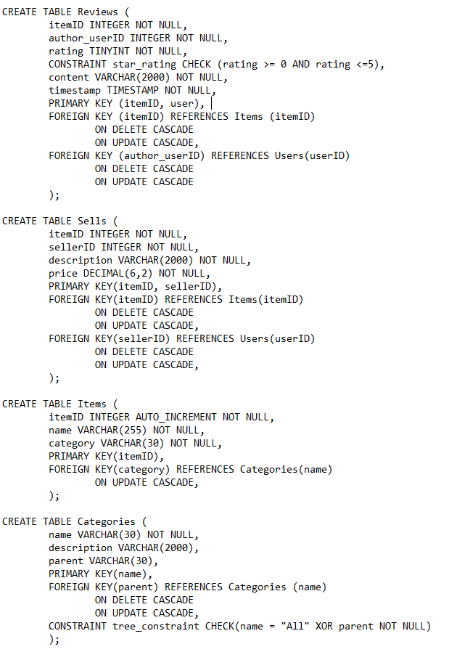
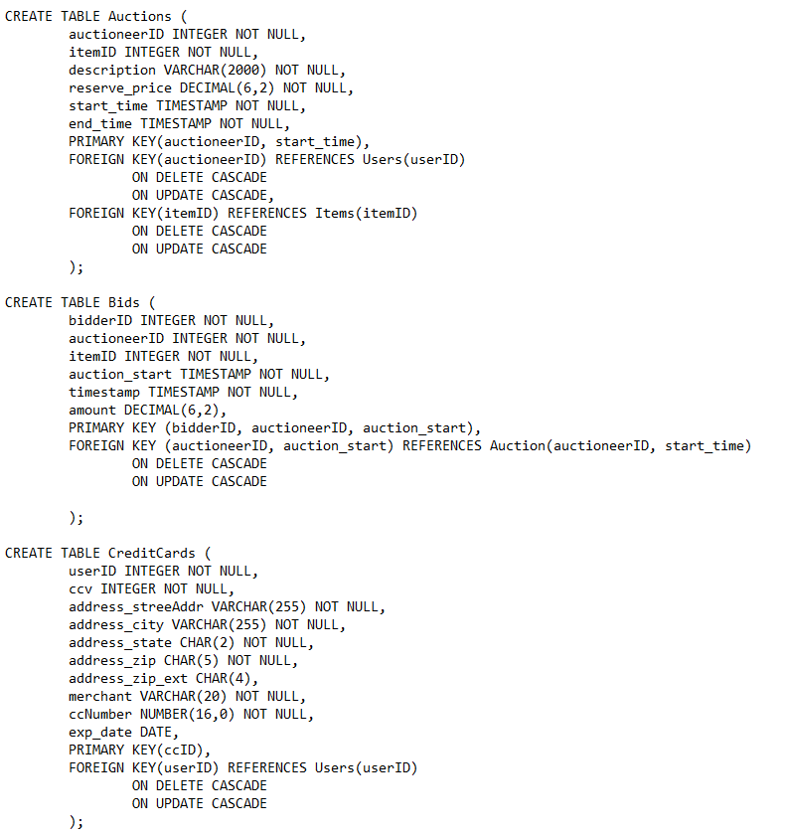
Final Schema

Slide 4
User Types

